Slide 1
Good practice#1 - Text orientation
1. Make text smaller
2. Select “Horizontal” again
3. Consider the format
4. Consider a bar chart

Slide 2
Good practice#1 - Text orientation
1. Make text smaller
2. Select “Horizontal” again
3. Consider the format
4. Consider a bar chart

Slide 3
Good practice#2 – Color coding
Low to high (good on maps)
Increase, neutral, decrease
Temperature
Sequential
Want something faded?
Transparency →
Grey it out →

Slide 4
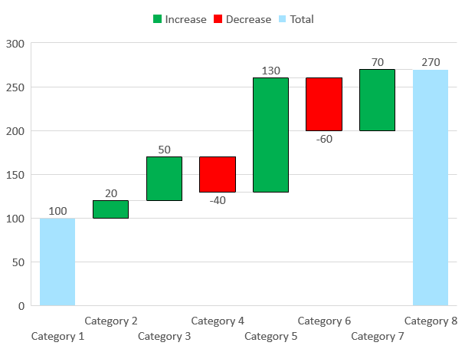
Good practice#2 – Color coding

Slide 5
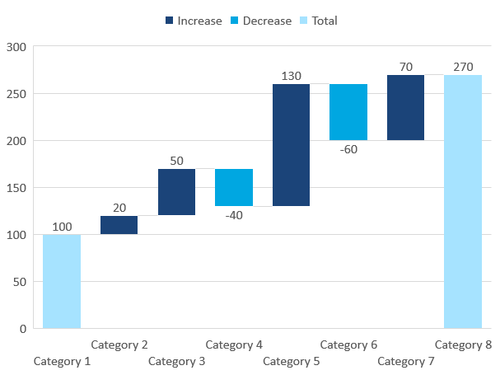
1. Color code the increase and decrease on this chart
Good practice#2 – Color coding

Slide 6
Good practice #3 – Visual Sorting

Slide 7
1. Sort items largest to smallest with the Edit Data function
Good practice #3 – Visual Sorting

Slide 8
Good practice #4 – Editing

Slide 9
1. Color code the 3 largest categories
2. Add data labels and make them bigger
3. Give the Horizontal and Vertical axis a line fill
Good practice #4 – Editing

